Slide 1
Primary SBA
Ben

Slide 2
Anti-cholinergic syndrome is the effect of muscarinic receptor blockade causing delirium, mydriasis, tachycardia and a dry mouth. Which of the following drugs is least likely to cause anti-cholinergic syndrome?
Hyoscine Cyclizine Promethazine Amitriptylline Glycopyrronium
Central Anti-Cholinergic Syndrome is a consequence of Glycopyrrolate is a peripherally acting anti-cholinergic so does not cross the blood brain barrier so the risk of central cholinergic syndrome is reduced.

Slide 3
Which of the following is most correct regarding high pressure safety features of the anaesthetic machine?
The APL valve will automatically adjust itself to match the patient’s compliance during spontaneous ventilation The anaesthetic reservoir bag has a maximum pressure of 50 cmH2O above which it will continue to expand The Fresh Gas Flow will automatically decrease as the pressure within the circuit increases The High pressure alarm always triggers at a pressure of 30 cmH2O The anaesthetic machine circuit may be damaged at peak pressures of 30 cmH2O
There are many high pressure safety features to protect the patient and machine from high pressures(>50 cmH20) within the circuit. The anaesthetic reservoir bag has a maximum internal pressure of 50cmH20 meaning that it will continue to expand until it bursts. The APL valve has a maximum pressure of 70cmH20 and will vent gas above that (it does not automatically change venting pressure). The FGF is set by the anaesthetist. The high pressure alarm is set by the anaesthetist although the default may be 30 cmH20. The anaesthetic machine is not damaged by high or low flows, but may be damaged by very high pressures.

Slide 4
Which of the following is most true about O2 Flush button?
The flow of oxygen is between 35 – 75 L/min Oxygen passes directly through the flowmeter and vapourising chamber to the common gas outlet The safety pressure valve limits patient exposure to 50 cmH2O The O2 flush button will increase the percentage of sevoflurane in the circuit Modern anaesthetic machines do not have an oxygen flush machine
The oxygen flush button opens a valve which directly opens the pipeline oxygen into the circuit at pipeline pressure at 4 bar (>4000 cmH20) and 35 to 75 L/min. The oxygen does not pass throught the flowmeter or vaporiser. There is no pressure safety valve so patients are at risk of barotrauma from pressing the oxygen flush button. Pressing the oxygen flush button will decrease the sevoflurane concentration in the circuit putting the patient at risk of awareness. Modern and old anaesthetic machines have an oxygen flush button.

Slide 5
Which of the following is most correct regarding the Swan-Ganz Pulmonary Artery (PA) Catheter?
There are no contraindications to insertion of a PA catheter The indications for PA catheter are cardiovascular surgery, right heart mass and intracardiac tumour. The normal CVP is 5 – 15 mmHg and the normal RVP is 0 – 25 mmHg It is not possible to measure the central venous pressure using a PA catheter The catheter is 50cm long and the correct insertion length is 30cm for the IJV
The Swan-Ganz catheter is a long central line with a pressure transducer, thermistor and injection port. It was designed to help assess the cardiac output to guide fluid administration, vasopressor and inotrope infusions. It is 110 cm long and is inserted to a length of 40 cm from the internal jugular vein to the pulmonary artery. The pressure transducer transmits the pressure from each vessel through

Slide 6
A 55 year old patient is booked on the CEPOD list for an emergency Laparoscopic Appendicectomy. She has had a left mastectomy and axillary node clearance. She currently has no IV access in situ. You have been unable to cannulate the patient after 3 failed attempts in the right arm and one attempt in the right foot. She tells you that her left arm is not to be used for blood pressure measurement or cannulation. You have been unable to cannulate the patient after 3 failed attempts in the right arm and one attempt in the right foot. What is the most appropriate next step?
Insert a cannula into the left antecubital fossa Intraosseus access Postpone the case due to lack of IV access Ketamine and Suxamethonium IM Right IJV CVC

Slide 7
A 28 year old male patient is being anaesthetised for a laparoscopic appendicectomy. He has no known medical conditions and takes no regular medication. He has been hypotensive and tachycardic in A&E and so has been treated for sepsis with antibiotics, fluid resuscitation and insertion of an arterial line. His capillary blood gas is 6.2 but his arterial blood gas shows a glucose reading of 25 on serial measurements. What is the cause of the discrepancy between arterial and capillary blood gas readings?
The patient is hyperglycaemic due to sepsis The patient is hyperglycaemic due to undiagnosed diabetes Measurement error in gas analyser Inappropriate use of Glucose 5% as arterial line pressurised fluid Sampling error due to inadequate finger tip cleaning

Slide 8
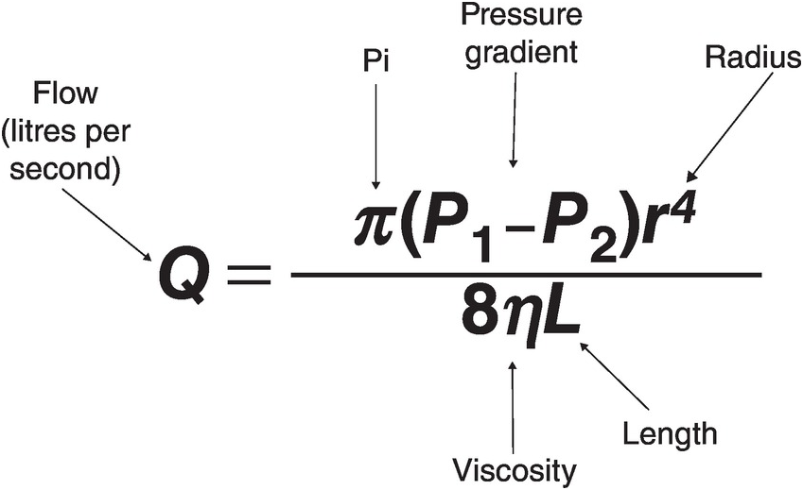
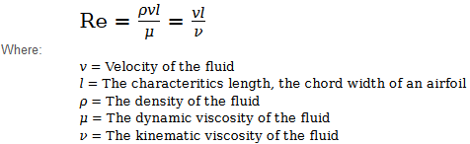
Which of the following is most correct regarding laminar flow?
As the diameter of an endotracheal tube increases the likelihood of turbulent flow increases Turbulent flow is more likely in a size 5.0 ETT compared to a size 6.0 ETT A Reynolds number of >5000 indicates laminar flow is highly likely Highly viscous fluids are more likely to exhibit turbulent flow Heliox is used for upper airway obstruction because it has a lower viscosity than oxygen

Slide 9
A 75 year old man is undergoing a TURP under GA. The ECG monitor shows ST depression and the systolic blood pressure has dropped from 145 to 110. Which is the most appropriate immediate treatment?
Isosorbide mononitrate GTN spray Adrenaline Metaraminol Fluid bolus
GTN is the most important immediate treatment for NSTEMI during an operation. This patient has ECG changes indicative of cardiac ischaemia so the theatre staff and surgeon should be notified, a 12 lead ECG should be performed and senior help should be sought. Early treatment of GTN will help with coronary vasodilatation and coronary perfusion. IMN would help but this patient is unlikely to be able to IMN orally so this is inappropriate. Adrenaline and Metaraminol might increase cardiac inotropy and worsen the coronary ischaemia. A fluid bolus may be indicated but GTN is more appropriate in this case.

Slide 10
A 26 year old man is booked to undergo a thyroidectomy and requires intubation. He reports that last time he had an anaesthetic he had to be admitted to intensive care for 6 hours due to a breathing problem but went home the next day. What would be the most appropriate muscle relaxant for this procedure?
Rocuronium Suxamethonium Mivacurium No muscle relaxant required Propofol and Remifentanil TCI
This patient may have a history of suxamethonium apnoea requires intubation for the procedure. Suxamethonium and Mivacurium would be poorly metabolised and take hours to wear off. Rocuronium is the safest choice. Muscle relaxant is preferrable for insertion of endotracheal tubes. Propofol and Remifentanil might not satisfactorily relax the patient for intubation.

Slide 11
Which of the following is most correct regarding the thoracic diaphragm:
The sensory afferents of the diaphragm are conducted by the phrenic nerve only The diaphragm is innervated by the vagus nerve Presence of a hiatus hernia is of little concern to the anaesthetist The rate of phrenic block after interscalene block is 50% The motor function of the diaphragm is mostly controlled by the phrenic nerve
The diaphragm is controlled entirely by the phrenic nerve. The sensory afferents travel in the phrenic nerve, intercostal nerve and subcostal nerves peripherally (not the vagus nerve). The diaphragm developed embryologically in the cervical spinal region which is why the phrenic nerve has roots of C3, 4, 5. A hiatus hernia is of great significance to the anaesthetist because it indicates a high risk of reflux and aspiration. This risk might be managed by inserting an ETT or performing a Rapid Sequence Induction (RSI). The rate of phrenic nerve block from an interscalene injection is around 100%..

